Slide 1
Human Data Analytics A.Y. 2022/2023
Final Project: Lymphoma Subtype Classification
Gianpietro Nicoletti 2053042¹ , Stefano Campagnola 2058080²
¹Department of Information Engineering, ICT for Internet and Multimedia, University of Padua
²Department of Physics and Astronomy, Physics of Data, University of Padua

Slide 2
What is Lymphoma?
Lymphoma is a type of cancer that affects the lymphatic system
Digital pathology (DP) involves the capture, storage, sharing, and analysis of high-resolution images of microscopic slides
Relation between the two: digital pathology has a significant impact on the diagnosis, consultation, research, and overall management of lymphoma
Machine learning techniques are suitable for automated diagnosis

Slide 3
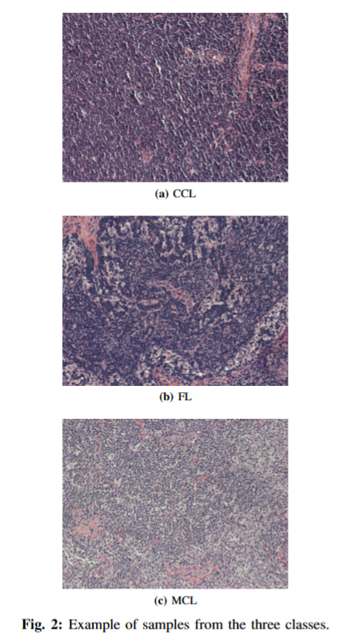
Dataset
374 RGB images from the National Institute of Ageing (NIA) of size 1388x1040
Three classes:
Chronic lymphocytic leukaemia (CLL)
Follicular lymphoma (FL)
Mantle cell lymphoma (MCL)
Train/validation/test splitting:
70% train
10% validation
20% test

Slide 4
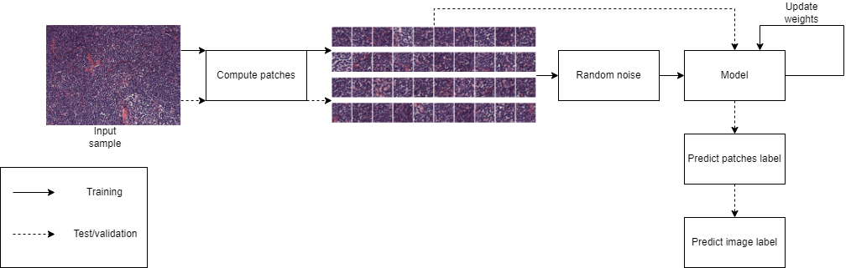
Pipeline

Slide 5
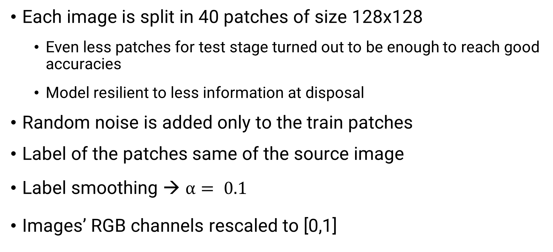
Data preprocessing
Each image is split in 40 patches of size 128x128
Even less patches for test stage turned out to be enough to reach good accuracies
Model resilient to less information at disposal
Random noise is added only to the train patches
Label of the patches same of the source image
Label smoothing → $α= 0.1$
Images’ RGB channels rescaled to [0,1]

Slide 6
Self-supervised learning
Self-supervised learning is a machine learning technique in which a model learns to extract meaningful representations or features from unlabelled data
Pretext task is a side objective of the model that guides the achievement of the main task:
Pretext task → image reconstruction
Main task → image classification
In our case: image reconstruction task will help our model on building an efficient latent representation

Slide 7
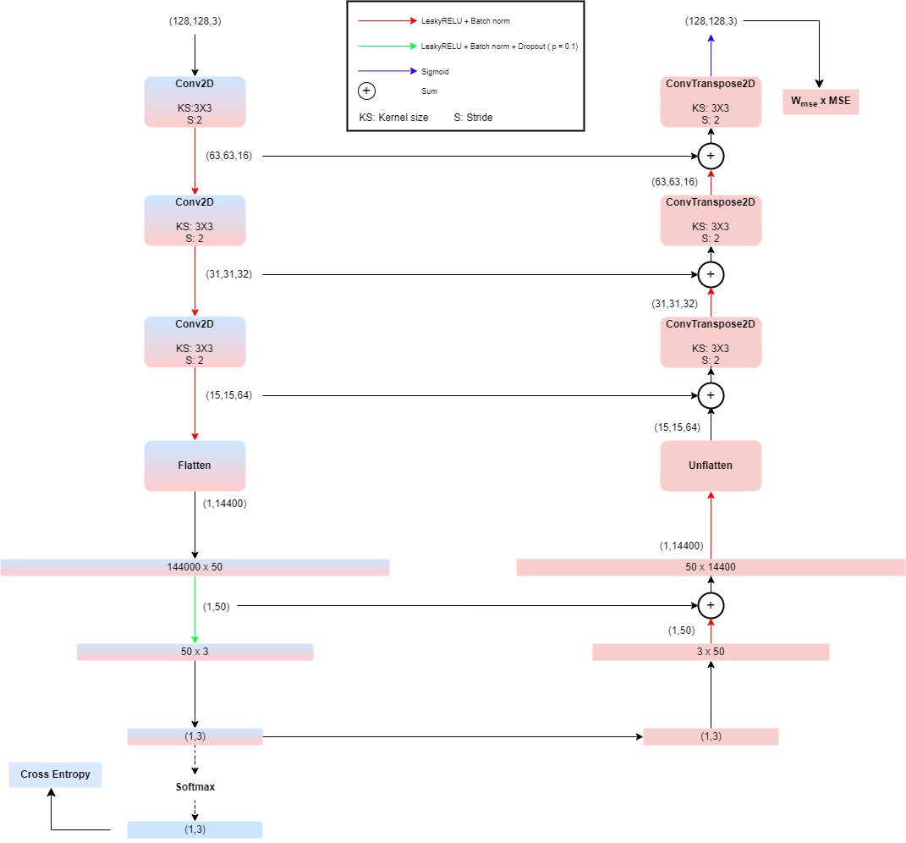
Architecture
Classifier → encoder part + softmax
Autoencoder → encoder + decoder + sigmoid
Skip connections inspired by U-net

Slide 8
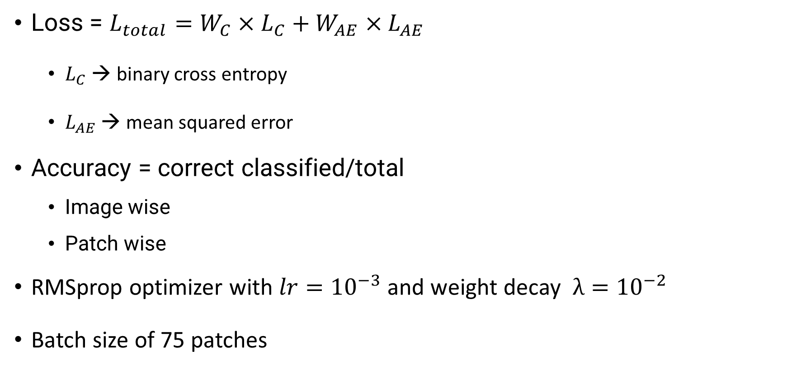
Training setup
Loss = $L_{total}=W_{C}×L_{C}+W_{AE}×L_{AE}$
$L_{C}$ → binary cross entropy
$L_{AE}$ → mean squared error
Accuracy = correct classified/total
Image wise
Patch wise
RMSprop optimizer with $lr={10}^{−3}$ and weight decay $λ={10}^{−2}$
Batch size of 75 patches

Slide 9
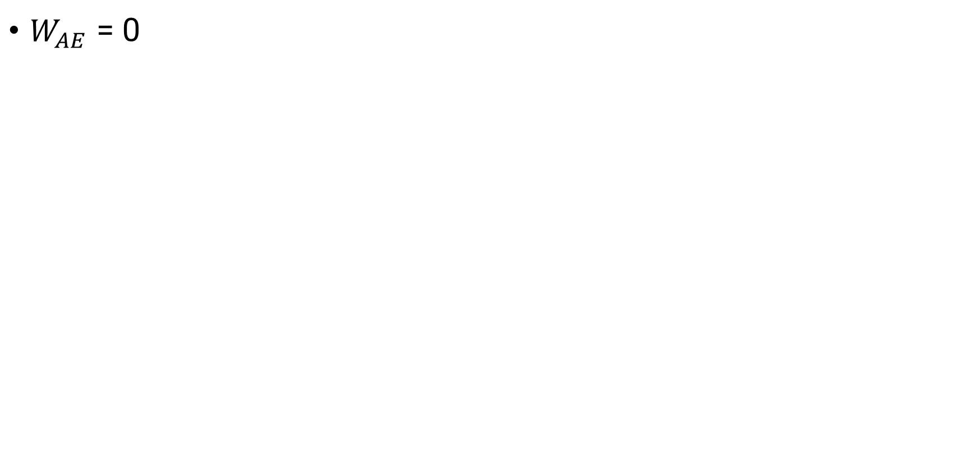
Baseline
$W_{AE}$ = 0

Slide 10
Thank you for your attention

